Slide 1
Build Real-Time software with ASP.NET Core SignalR
Rachel Appel
Microsoft
http://rachelappel.com
rachel@rachelappel.com

Slide 2
Agenda
SignalR Overview
Common Usage Patterns for Real Time Software
Create communications Hubs and Clients
Send messages
Deploy
Migration

Slide 3
ASP.NET Core SignalR
Entirely rewritten based on common usage patterns
Simpler, more reliable, easier to use
Similar APIs
TypeScript
Support for binary and custom protocols
Simplified Scale-Out Model
SignalR is ASP.NET Middleware
Not backwards compatible
Notes:
Support for Binary Protocols
SignalR for ASP.NET Core offers two built-in hub protocols – a text protocol based on JSON and a binary protocol based on MessagePack. Messages using the MessagePack protocol are typically smaller than messages using the JSON protocol. For example a hub method returning the integer value of 1 will be 43 bytes when using the JSON based protocol while only 16 bytes when using MessagePack. (Note, the difference in size may vary depending on the message type, the contents of the message and the transport used – binary messages sent over Server Sent Events transport will be base64 encoded since Server Sent Events is a text transport.)

Slide 4
Common Usage Patterns & Types of Apps
Notifications
Games, leaderboards
Social Applications
Business Collaboration
Stocks
Chat, messaging
Dashboards
Real time forms
Auctions

Slide 5


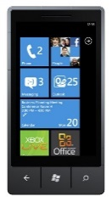

Architecture
?
?
Hub
?

Slide 6
Hubs
Derive from Microsoft.AspNetCore.SignalR.Hub
Define public methods
Async and return Task
Receive messages from client
Invoke client methods
SendAsync

Slide 7
Hub Definition
public class Hub : IDisposable {
public Hub();
public IHubCallerClients Clients { get; set; }
public HubCallerContext Context { get; set; }
public IGroupManager Groups { get; set; }
public void Dispose();
public virtual Task OnConnectedAsync();
public virtual Task OnDisconnectedAsync(Exception exception);
protected virtual void Dispose(bool disposing);
}

Slide 8
Hub Events
public override Task OnConnectedAsync()
{
return base.OnConnectedAsync();
}
public override Task OnDisconnectedAsync(Exception ex)
{
return base.OnDisconnectedAsync(ex);
}

Slide 9
Call client methods from hubs
public class ChatHub : Hub
{
public async Task SendMessage(string arg, string arg2)
{
await Clients.All.SendAsync("method", arg, arg2);
}
}

Slide 10
Hub.Clients property
All
AllExcept
Caller
Clients
Client(“id”)
Groups
Group(“name”)
Others
OthersInGroup(“name”)
User(“name”)
Users

Slide 11
Hub Context property
Retrieve Identity object
ConnectionId

Slide 12
Manage Groups
Groups
AddAsync
RemoveAsync
Notes:
First connection added to group creates group. There is no need to specifically create group

Slide 13
Connection Model
Try connection -> Fail -> Try connection with different transport -> repeat
The new version of SignalR does not support having more than one Hub per connection.
Notes:
In the previous version of SignalR the client would try starting a connection to the server, and if it failed it would try using a different transport. The client would fail starting the connection when it could not connect to the server with any of the available transports. This feature is no longer supported with the new SignalR
Another functionality that is no longer supported is automatic reconnects. Previously SignalR would try to reconnect to the server if the connection was dropped. Now, if the client is disconnected the user must explicitly start a new connection if they want to reconnect. Note, that it was required even before – the client would stop its reconnect attempts if it could not reconnect successfully within the reconnect timeout. One more reason to remove automatic reconnects was a very high cost of storing messages sent to clients. The server would by default remember the last 1000 messages sent to a client so that it could replay messages the client missed when it was offline. Since each connection had its own buffer the memory footprint of storing these messages was very high.
----
This results in a simplified client API, and makes it easier to apply Authentication policies and other Middleware to Hub connections. In addition subscribing to hub methods before the connection starts is no longer required.

Slide 14
DEMO

Slide 15
Client code workflow
Create connection
Setup client method for hub to call
Initialize connection by calling start
Notes:
https://weblogs.asp.net/ricardoperes/signalr-in-asp-net-core
A connection is created pointing to the current URL plus the chat suffix, which is the same that was registered in the MapHub call
It is initialized with a specific transport, in this case, WebSockets, but this is not required, that is, you can let SignalR figure out for itself what works; for some operating systems, such as Windows 7, you may not be able to use WebSockets, so you have to pick either LongPolling or ServerSentEvents
The connection needs to be initialized by calling start
There is an handler for the Send method which takes the same single parameter (xx) as the ChatHub’s XXX method

Slide 16
JavaScript client
npm install @aspnet/signalr
<script src="~/lib/signalr/signalr.js"></script>

Slide 17
JavaScript client
const connection =
new signalR.HubConnection("/chathub",
{ logger: signalR.LogLevel.Information });
connection.start().catch(err => console.log(err));

Slide 18
JavaScript client: invoke hub method
connection.invoke("method", user, message)
.catch(err => console.error);

Slide 19
.NET Client
Nuget package
Open connection
Start Connection

Slide 20
.NET Client
Microsoft.AspNetCore.SignalR.Client Nuget package
Notes:
https://dotnetthoughts.net/getting-started-with-signalr-using-aspnet-core/

Slide 21
.NET Client: Invoke hub method
.NET client
await connection.InvokeAsync("method", arg, arg2);

Slide 22
DEMO

Slide 23
Formats
JSON and Binary

Slide 24
Secure SignalR apps
SignalR doesn’t provide a security feature
Use built-in ASP.NET Core or 3rd party

Slide 25
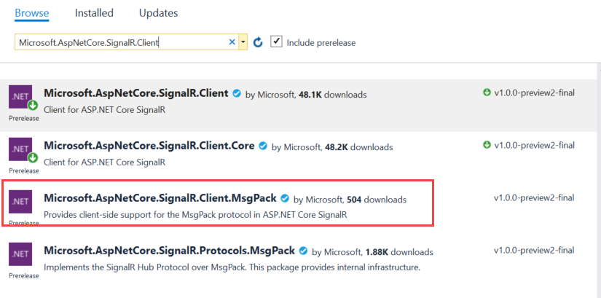
MessagePack
https://www.npmjs.com/package/@aspnet/signalr-protocol-msgpack

Slide 26
MessagePack
Modify startup enablemessagepacl
services.AddSignalR(options => { options.KeepAliveInterval = timeSpan.FromSeconds(5);})
.AddMessagePackProtocol();
Create regular hub and regular hub method, but use a class as argument
https://damienbod.com/2018/03/19/using-message-pack-with-asp-net-core-signalr/

Slide 27
Migrating: What’s new
It has a brand-new JavaScript client written in TypeScript and no longer depends on jQuery.
Simplified connection model
2 hub protocols: text protocol based on JSON & MessagePack.
Support for Custom Protocols
Improved and simplified scale-out model.
Sticky sessions are required due to the new scale-out model.

Slide 28
Migrating: What’s new
Persistent connections are removed
The lower level is being moved to ASP.NET Core
No more sessions
Streaming

Slide 29
Migrating from previous SignalR versions
Rewritten for ASP.NET Core; incompatible
NuGet & npm Packages
SignalR
Change to async
JavaScript client changes
jQuery
Code and syntax

Slide 30
Deployment/Publishing
Azure Web Apps
WebSockets, ARR Affinity
Version dependent:
ASP.NET Core Runtime Extensions
HTTP 502.2 error on Azure Web Apps

